Slide 1
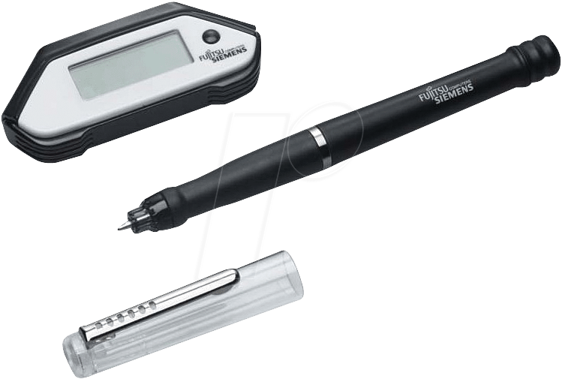
SEMINAR
ON
SMART NOTE TAKER
MADE BY:- RISHABH ARYA
13ECU106
Notes:
1

Slide 2

Introduction
The Smart Note Taker is such a helpful product that satisfies the needs of the people in today's technologic and fast life.
The Smart Note Taker is a pen that provides taking fast and easy notes to people who are busy one's self with something.
The written notes will be stored in memory chip of the pen and will be able to read in digital medium after the job is done.
This will save time and facilitate life.

Slide 3
Features Of Smart Note Taker
With the help of smart note taker handwritten notes will be instantly converted into editable text.
It is good and helpful for blinds that think and write freely.
While people talking on phone , SNT can play an important role.
The subscriber are apart from each other while their talk, and they may want to use figures or texts to understand themselves better.
It’s also useful especially for instructors in presentations. The instructors may not want to present the lecture in front of the board.

Slide 4
Features Of Smart Note Taker
The drawn figure can be processed and directly sent to the server computer in the room
The server computer then can broadcast the drawn shape through network to all of the computers which are present in the room.
It recognizes up to 22 Languages : English – Canada , English - GB, English-US ,German , Simplified Chinese, Traditional Chinese ,Korean Danish, Spanish, Spanish - Mexico, Finnish, French , French-Canada, Greek, Italian, Japanese, Dutch, Norwegian, Portuguese , Portuguese-Brazil, Russian, Swedish.

Slide 5
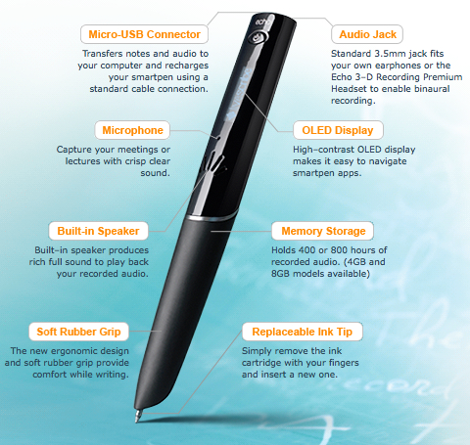
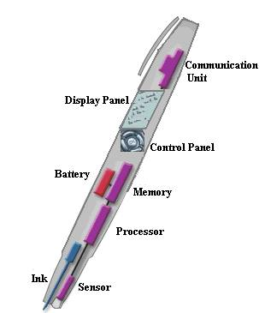
DIAGRAM

Slide 6
CONSTRUCTION AND WORKING
Since, JAVA applet is suitable for both the drawings and strings all these applications can be put together by developing a single JAVA applet program.
The java code that we will develop will also be installed on the pen so that the processor in the pen will be able to draw and type the desired text on the display panel.
Applet is a function of java which for example, is a kind of container (file) which contains a set of programs made in java.
This product will be simple but powerful. The product will be able to sense 3D shapes and motions that user tries to draw.
The sensed information will be processed and transferred to the memory chip and then will be monitored on the display device.
The drawn shape then can be broadcasted to the network or sent to a mobile device.

Slide 7
CONSTRUCTION AND WORKING
This application program can be a word document or an image file.
Then, the sensed that were drawn into the air will be recognized and with the help of the software program we will write the desired character which will be printed in the word document.
If the application program is a paint related program, then the most similar shape will be chosen by the program and then will be printed on screen.

Slide 8
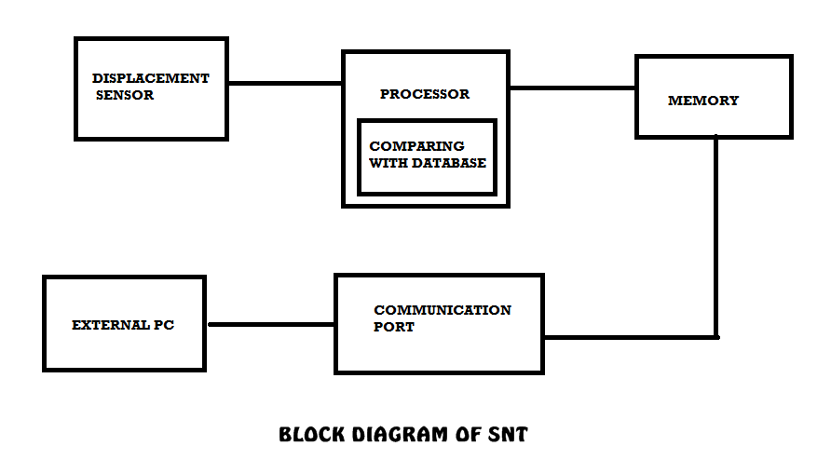
BLOCK DIAGRAM OF SNT

Slide 9
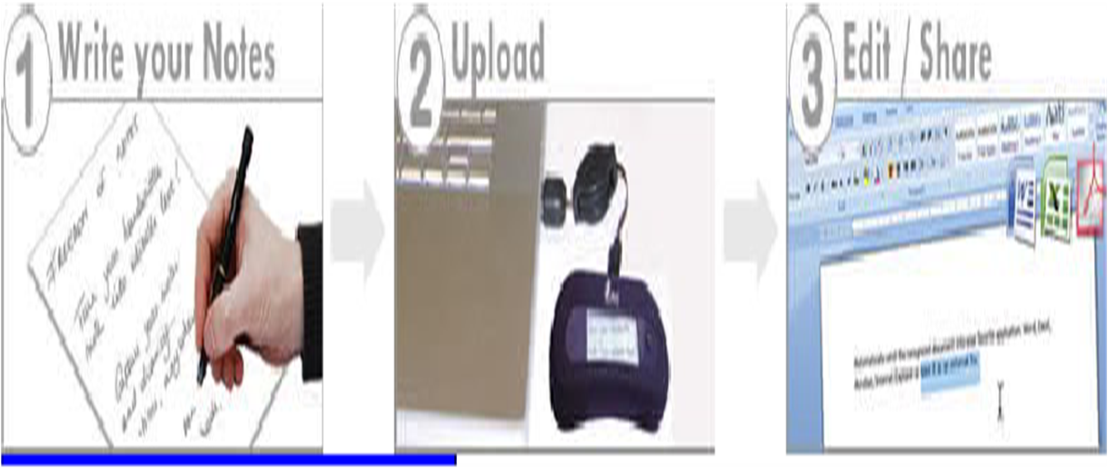
WORKING……
The working can be explained in 3 steps….
WRITE
UPLOAD
EDIT &SHARE

Slide 10
TECHINAL TERMS
Operating System
Software program to convert data into text or string format
Displacement Sensor
Parallel cable
Analog to digital converter
Switch
Rechargeable battery

Slide 11
CURRENT PRODUCTS
MOBILE NOTE TAKER
The Ultimate Handwriting Capture Device Mobile Note Taker TM is the world’s first portable handwriting capture device based on natural handwriting as an input.
PC NOTE TAKER
PC Notes Taker is the world's first device that captures natural handwriting on any surface onto a PC in real time.

Slide 12
Advantages
With the help of smart note taker we can write notes on any surface even in air. That is we can write notes any time without using a paper. So we get information in very fast and easy way. Hence it is time saving.
Smart note taker is reliable and powerful.
It is helpful for blinds that think and write freely.
Smart note taker is used for instructors in presentations.
Easy-to-use wireless connection.
It is used along with paint and JAVA graphics so we can say this product is compatible with all graphics software.
It is time saving.

Slide 13
Disadvantages
Cost of note takers is very high.
Only high class people can afford this type of note takers.

Slide 14
CONCLUSION
Hence , we can conclude that our product has many advantages over digital pen , since the smart note taker is a device that can store visual recordings and thus can be used widely.
The device takes a practical extent since it offers high mobility.
The price of innovation will be reasonable for the sectors that can use it effectively in their business or lessons.

Slide 15
Thanks…!!!!

